Slide 1
AUDIO CLASSIFICATION DEEPLEARNING
USING
NAME : SRINATH R
NM-id : au711721243108
KGISL INSTITUTE OF TECHNOLOGY
3/21/2024 Annual Review

Slide 2
PROJECT TITLE
Audio classification using deeplearning
3/21/2024 Annual Review

Slide 3


AGENDA
The objective of this project is to construct a deep learning framework for audio classification utilizing the UrbanSound8K dataset. The process entails extracting crucial attributes from audio files and subsequently training a model to categorize them into predefined classes.
3/21/2024 Annual Review

Slide 4

PROBLEM STATEMENT
Automated urban sound classification plays a vital role in urban planning, noise surveillance, and public safety efforts. However, manual classification methods are both time-intensive and prone to subjectivity. Therefore, there's a pressing need for an automated system to ensure precise and efficient classification processes.
3/21/2024 Annual Review

Slide 5

PROJECT OVERVIEW
This project seeks to develop a sophisticated deep learning model tailored for categorizing urban sounds such as "car horn," "dog bark," "siren," among others. Its scope encompasses audio preprocessing, feature extraction, neural network architecture design, training procedures, and thorough performance assessments.
3/21/2024 Annual Review

Slide 6
WHO ARE THE END USERS?
Urban planners benefit from the project's outcomes by leveraging urban sound classification to gain insights into noise distribution across different areas, facilitating informed urban planning and zoning decisions. Meanwhile, environmental agencies utilize the model to monitor noise pollution levels effectively, empowering them to implement tailored interventions to alleviate environmental impact and ensure public health.
3/21/2024 Annual Review

Slide 7

YOUR SOLUTION AND ITS VALUE PROPOSITION
Our solution revolves around developing a highly accurate deep learning model adept at efficiently categorizing urban sounds through in-depth analysis of their audio features. This automated methodology substantially decreases the time and resources needed when contrasted with manual classification techniques. Moreover, it provides instantaneous evaluation of urban soundscapes, enabling swift responses to emergencies or atypical noise events.
3/21/2024 Annual Review

Slide 8

THE WOW IN YOUR SOLUTION
Our solution's standout feature lies in its outstanding precision and recall when classifying a wide range of urban sounds, showcasing remarkable accuracy. Its ability to generalize effectively to unseen data and process information in real-time makes it a formidable asset for conducting thorough urban sound analyses.
3/21/2024 Annual Review
8

Slide 9
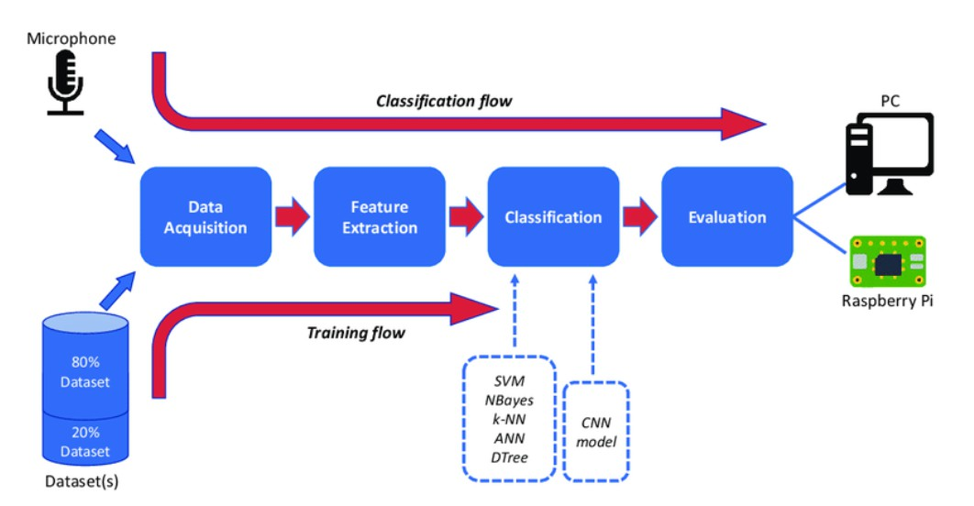
MODELLING
Description of the deep learning model architecture.
Explanation of model training and evaluation processes.
3/21/2024 A nual Review
9
n

Slide 10
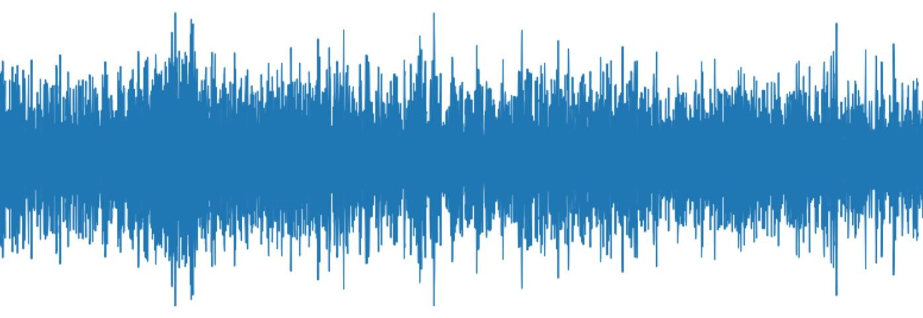
RESULTS
This project proposal outlines the objectives, target users, and key features of our audio classification solution for urban sounds. By addressing the problem of manual classification and providing an automated, efficient solution, our project aims to make a positive impact in urban planning, environmental monitoring, and public safety.
https://drive.google.com/file/d/1XY1mjCXi3HI8lnJZeQu7I-7311JBnPjc/view?usp=drive_link
10

